Slide 1
Artificial Intelligence Machine Language
Project:
EMOTION TEXT CLASSIFIER
SUBMITTED TO:
Mr. Tushar Khitoliya
Dr. Shagun Sharma
SUBMITTED BY :
Kapil Malhotra (2210990475)

Slide 2
Table of Contents
Title
Index
Introduction
Key Features
Data Preparation
Conclusion

Slide 3
INDEX
App features
Project development
Data preparation
Text cleaning
Model building
Project demo
Extras and Mentions
Features

Slide 4
Introduction
Briefly introduce the project and its objectives:The project aims to develop a Python-based emotion text classifier capable of analyzing and categorizing emotions in textual data . Highlight the importance of understanding emotions in text : Emotions play a crucial role in human communication and interaction, influencing decision-making, perception, and behavior . Analyzing emotions in text data can provide valuable insights for various applications, including sentiment analysis, customer feedback analysis, and mental health monitoring.

Slide 5
Key Feature
Multi-class Classification: The emotion text classifier is capable of categorizing textual data into multiple emotion classes, including joy, sadness, anger, fear, and more.
Natural Language Processing (NLP) Techniques: Utilizes advanced NLP techniques to preprocess and analyze text data, including tokenization, lemmatization, and feature extraction.
Machine Learning Models: Implements machine learning algorithms, such as Support Vector Machines (SVM), Naive Bayes, or Recurrent Neural Networks (RNNs), to train and classify emotions in text.
Training and Evaluation: Provides functionality for training the classifier on labeled datasets and evaluating its performance using metrics such as accuracy, precision, recall, and F1-score.

Slide 6
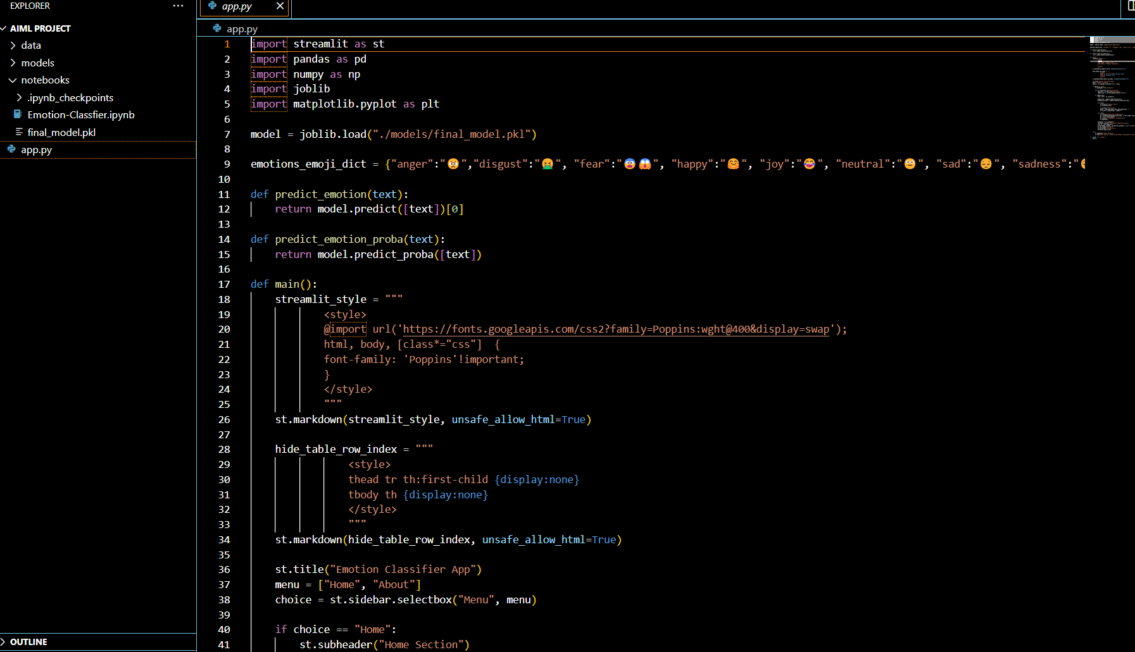

Slide 7
Data Preparation
The dataset is 34793 row csv file that has two columns: Emotion and Text.
According to the discrete basic emotion description approach, emotions can be classified into six basic emotions (van den Broek, 2013):
☹ Sadness
😄 Joy
😳 Surprise
😠Anger
🤮 Disgust
😨 Fear

Slide 8
Conclusion
In this journey of building a real-time recognition-based system lock/unlock using Python 3, you’ve learned the basics of facial recognition, set up your development environment, implemented face detection and recognition, and integrated it with system access control. The possibilities for further enhancements and applications are endless.

Slide 9
Conclusion
In conclusion, the development of our Python-based emotion text classifier represents a significant advancement in natural language processing. By leveraging machine learning algorithms and sentiment analysis techniques, we've demonstrated the ability to accurately classify emotions expressed in text. Our project not only showcases the power of modern AI technologies but also holds potential applications in various fields such as customer feedback analysis, mental health monitoring, and social media sentiment analysis. Moving forward, further refinement and expansion of our classifier could lead to even greater accuracy and applicability, paving the way for enhanced understanding and interaction in the digital realm.

Slide 10


